Slide 1
Study BOT
using python
Guided By :
Prof. S. M. Jaybhaye
Presented By :
SEDA 7
Rucha Uplenchwar
Mukta Patil
Pratham Gajbhiye
Rahul Nagpure

Slide 2
01
02
03
INTRODUCTION
FEATURES
REQUIREMENTS
04
05
06
LIBRARIES USED
WORKING
OUTPUT
07
08
09
ADVANTAGES
LIMITATIONS
FUTURE SCOPE

Slide 3
01.
INTRODUCTION

Slide 4

Introduction
Study Bot is a virtual assistant that can interpret voice commands.
It automates certain academic task.
It is customized to benefit students.
It is more inclined towards helping VIT Students
Along with academic tasks, certain useful features are included as well.

Slide 5
02.
FEATURES

Slide 6

Features
1
OPEN GOOGLE
2
OPEN YOUTUBE
3
PLAY SONGS
4
OPEN GOOGLE MEET LINK
5
OPEN NOTES FROM GOOGLE DRIVE
6
OPEN EDUPLUS PORTAL
7
OPEN VOLP PORTAL
8
SEARCH INFO ON WIKIPEDIA
9
OPEN CERTAIN APPS IN WINDOWS
10
SEND MAILS
11
WEATHER REPORT
12
TELL RANDOM JOKES

Slide 7
03.
REQUIREMENTS

Slide 8



REQUIREMENTS
SOFTWARE REQUIREMENT
HARDWARE REQUIREMENT
RAM – 4 GB or more
Hard disk – 256 GB or more
Internet Connection
Windows 7/10
Visual Studio Code
Python

Slide 9
04.
LIBRARIES USED

Slide 10

Libraries Used
1
pyttsx3
2
speech_recognition
3
datetime
4
wikipedia
5
webbrowser
6
os
7
smtplib
8
requests
9
random
10
BeautifulSoup
11
tkinter
12
PIL

Slide 11
05.
WORKING

Slide 12
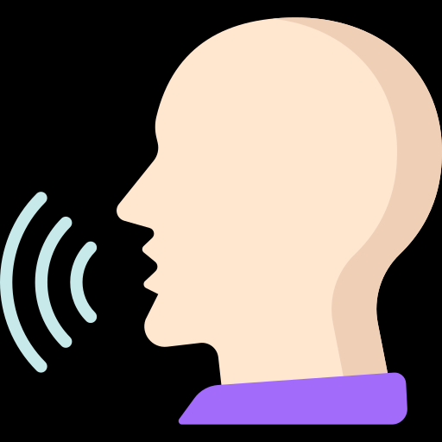



Working
1
2
3
4
SPEAK
LISTENS
RESPONSE
ACTION
Activate Study Bot and Speak Something
Study Bot takes input as audio and match with available commands
If it is available then the proper response is provided
And Proper Action is taken

Slide 13
06.
OUTPUT

Slide 14
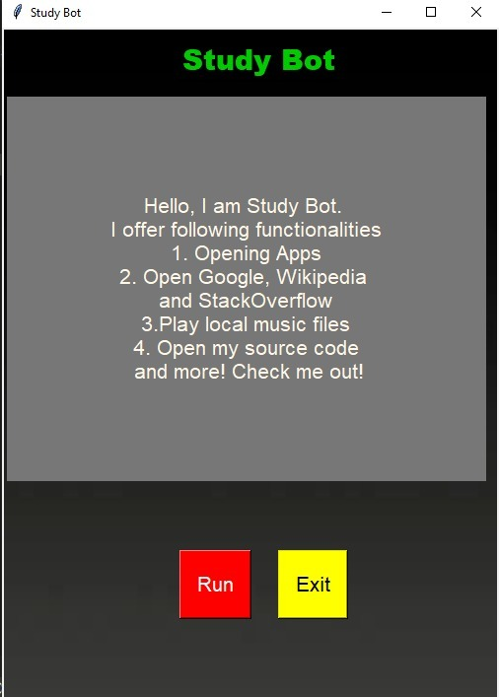
STUDY BOT GUI

Slide 15

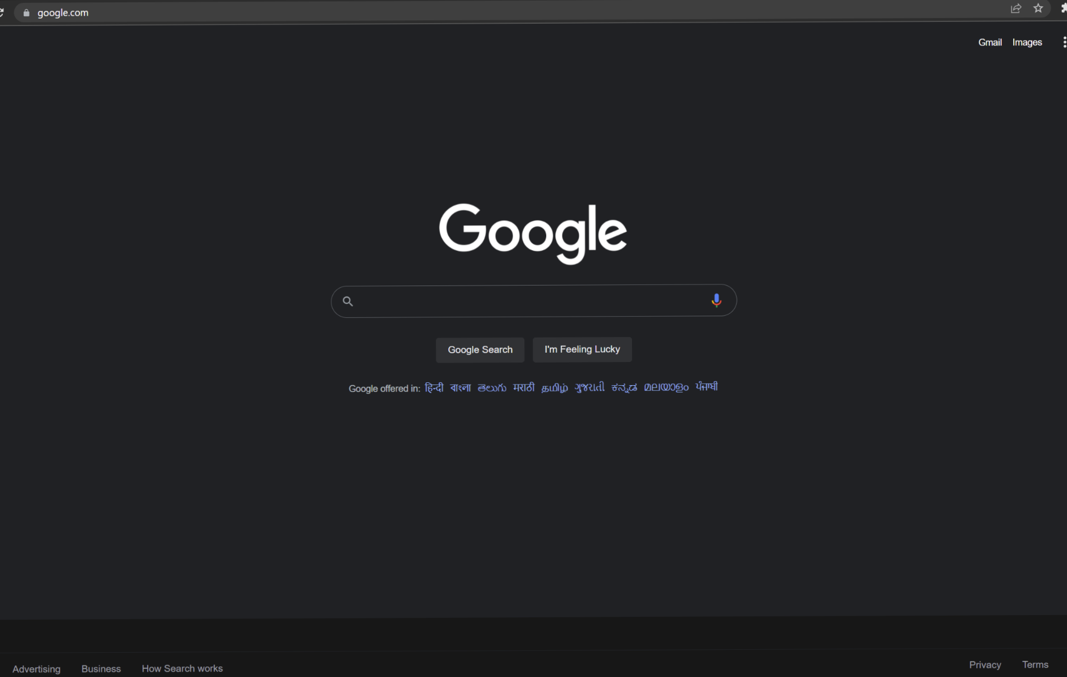

OUTPUT
COMMAND : Open Google

Slide 16
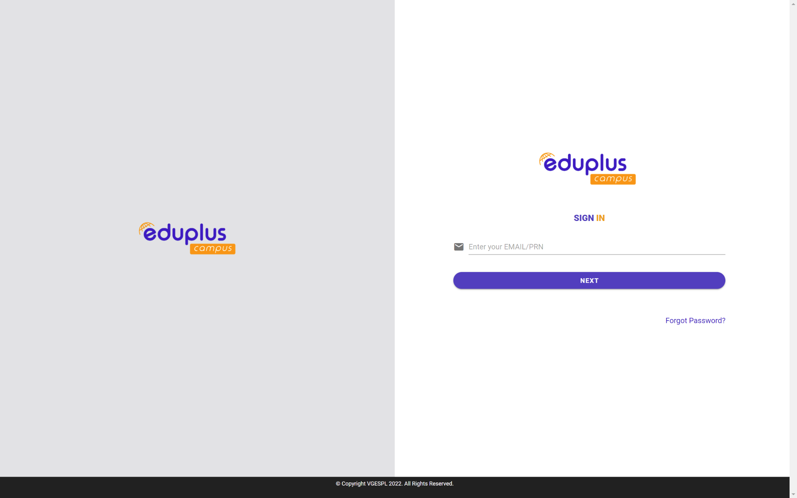

OUTPUT
COMMAND : Open eduplus portal

Slide 17
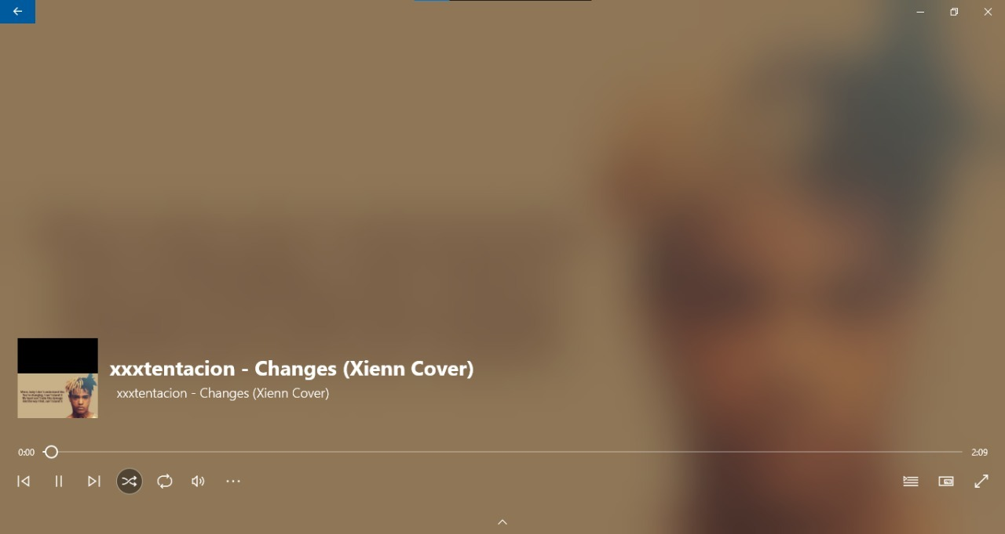
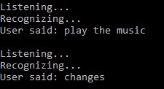
OUTPUT
COMMAND : play the music

Slide 18
07.
ADVANTAGES

Slide 19
1
2
AUTOMATES VARIOUS SIMPLE TASKS
ACCURATELY INTERPRETS VOICE COMMANDS
Advantages
3
4
Study Bot has Several Advantages
LAUNCHES VARIOUS APPLICATION PROGRAMS LIKE WORD ON COMMAND
IMPLEMENTS BASIC WEB SCRAPING TO FIND INFORMATION FROM WIKIPEDIA

Slide 20
08.
LIMITATIONS

Slide 21
1
2
STATIC AND MOST CODE IS HARD CODED
LITTLE SCOPE FOR IMPLEMENTATION OF GUI
Limitations
3
4
ONLY BASIC WEB SCRAPING
REQUIRES INTERNET CONNECTION ALL THE TIME

Slide 22
09.
FUTURE SCOPE

Slide 23
Future Scope
1
2
3
GUI
ADVANCED WEB SCRAPING
OTHER LANGUAGES
User-friendly GUI can be integrated to better show how the application works.
We can program the application to take input in languages other than english and still produce the desired result.
Instead of just showing output from wikipedia, we can code the application to show google search page of given query.

Slide 24
Future Scope
4
5
PLAYING SPECIFIC VIDEO FROM YOUTUBE
ADDING MORE FUNCTIONALITIES
Currently, the system launches the youtube website but cannot play a specific video yet.
More functionalities like opening camera, opening a specific file from system and more can be added.

Slide 25
CONCLUSION
INSPIRE
“Study Bot is a quite useful virtual assistant. It opens necessary academic resources over a single command. It certainly takes some load off the students. Though a lot more can be, Study Bot effectively achieves its goals.”
STUDY BOT

Slide 26
Thanks!

